Slide 1

INT247 Machine Learning Foundations
Lecture #4.1
Data Preprocessing

Slide 2
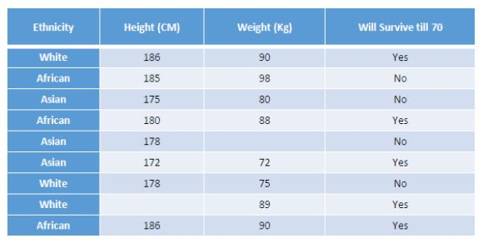
Data Preprocessing
Dealing with missing data.
Handling categorical data.

Slide 3
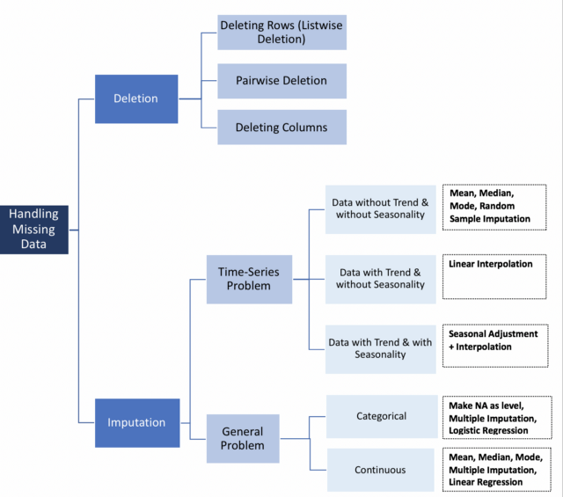
Dealing with missing data
An error in the data collection process leads to missing data.
Missing values are represented as blank spaces or NaN string.

Slide 4
Eliminating samples or features with missing values
Remove the column entirely with missing values.
Remove the rows with missing values.
Only drop rows where all columns are NaN.
Drop rows that have not at least “threshold” non-NaN values.
Only drop rows where NaN appear in specific columns.

Slide 5
Imputing missing data
Removal of entire row/column may lose too much valuable data.
Different interpolation techniques can be used to estimate the missing values like mean/median/mode imputation.
Mean Imputation: replace the missing value by the mean value of the entire feature column.

Slide 6
Handling Categorical data
Mapping ordinal features.
Encoding class labels.
Performing one-hot encoding on nominal features.

Slide 7
Mapping Ordinal Features
Ordinal features are sorted or ordered.
For example:
Size of T-Shirt: XL>L>M
Convert string values into integer.
For example:
XL=L+1=M+2

Slide 8
Encoding Class Labels
Nominal features are not ordered.
For example:
Color of T-Shirt: green, red, blue.
Assign numeric value to each feature.
For example:
green: 0, red: 1, blue: 2

Slide 9
Disadvantages of encoding class labels
Assigning numerical values to class labels may lead to wrong interpretation of data.
For example:
color coding shows that red is greater than green.

Slide 10
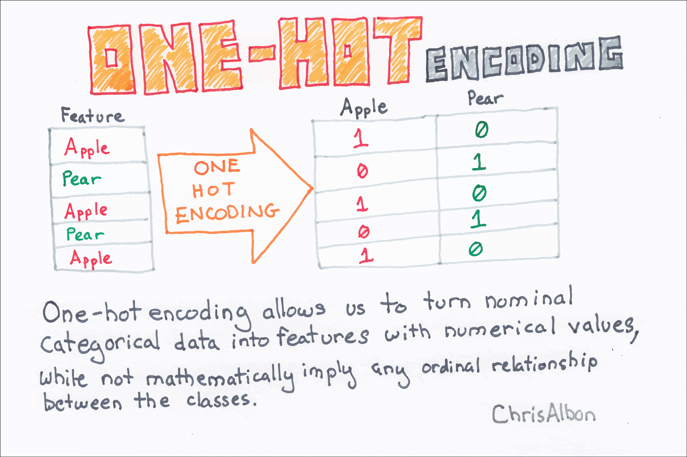
One-hot encoding on nominal features
Create a new dummy feature for each unique value.
Assign binary values to indicate a particular feature.
OneHotEncoder returns a sparse matrix.

Slide 11
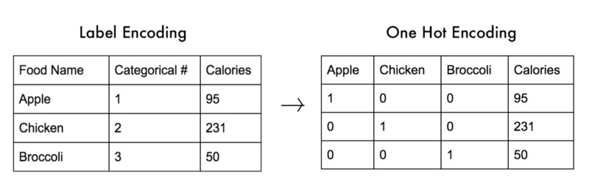
Label Encoding vs One Hot Encoding

Slide 12
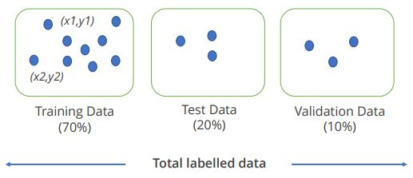
Partitioning a dataset
Training Data: it assists in learning and forming a predictive hypothesis for future data.
Test Data: data provided to test a hypothesis created via prior learning is known as test data.
Validation Data: it is a dataset used to retest the hypothesis.

Slide 13


